Slide 1

كلية العلوم الحاسوبية والمعلوماتية
تخصص هندسة البرمجيات
مناقشة مشروع
بعنوان:
Special Needs Conveyance (SNC)
Basem Damir (Team leader )
Elham Ali
Samar Abu Dayyeh
Fatin El-bitar
Supervisors: Dr. Mohmmad Nassar

Slide 2
The problem that we faced during the implementation of the project is that we found applications that work on the same principle, such as Uber, Careem, and Genie, but it does not specifically support this category of people, so we made this application to be only for this category.
Explanation of the problem:

Slide 3

It is an Android application designed for people with special needs to move them from one place to another at anytime and anywhere.
The main function of the application is that this group will request the car and driver suitable for them from their place, very quickly and without effort.
Application description:

Slide 4
This project aims to simplify the lives of this group of people daily.
Project goals in general.
Save effort and time and facilitate their transportation.
How to improve mobility and go to the right place for them
Corresponds to different disability groups age groups.
Reducing stress on the parents by having an assistant for the
Project goals and objectives

Slide 5
We simply chose to tackle this problem for two main reasons.
We want to contribute to helping this group of people simplify their lives without having to worry about mobility.
There are several applications for transportation, but they do not help this category of people and see them as difficult, so there will be equipped transportation and trained people in dealing with them.
Project motive

Slide 6
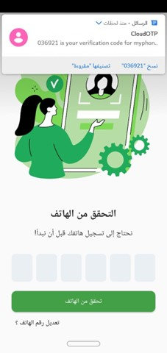
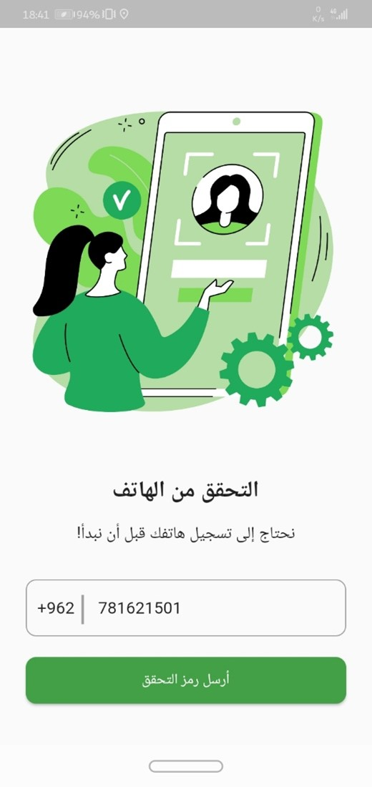
Welcome page:

Slide 7
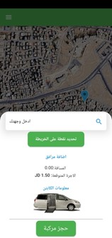
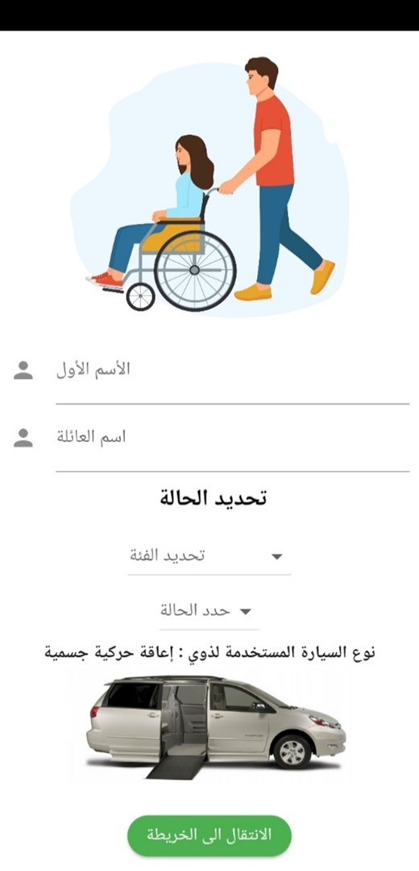
Select State

Slide 8
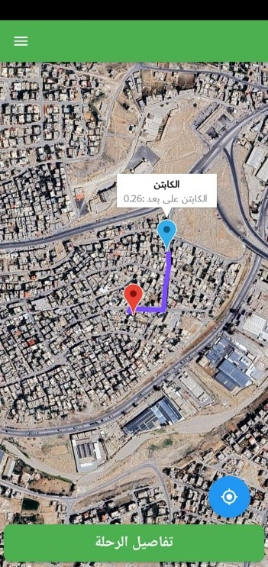
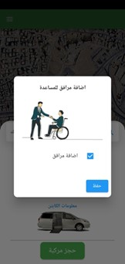
Home Service Page.

Slide 9
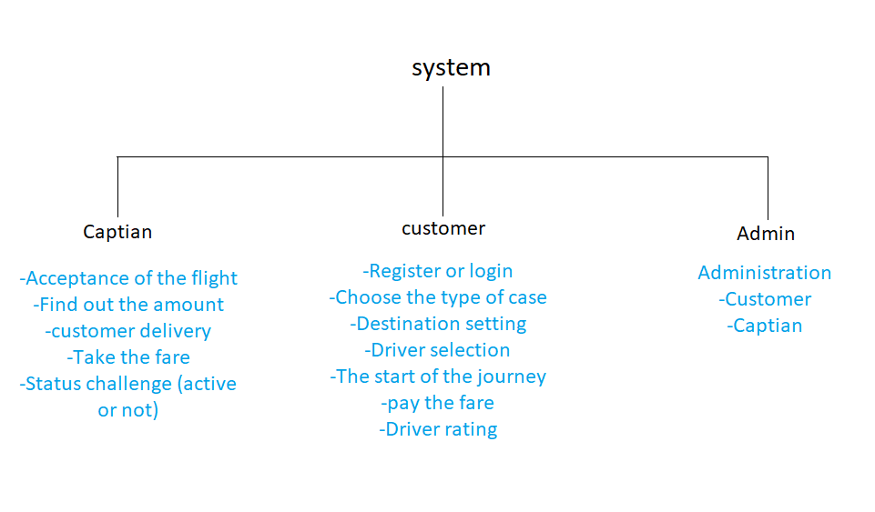

Slide 10
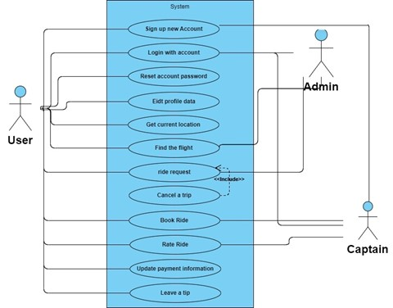
Use Case Diagram (SNC App)

Slide 11
Each user has evaluated the whole system services which include:
1. Easy to open the App.
2. How to choose a Trip.
3. Diversity in choosing a Trip.
4. How to request a user assistant.
5. How to see prices.
6. Choosing the round-trip service option.
7. Providing support equipment (wheelchair, crutches, braille board).
8. How to choose the type of Trip.
9. How to communicate with customer service.
Acceptance Test Forms

Slide 12
- Figma
- Android Studio
- Flutter
- sql server
Tools

Slide 13
Aims:
-To serve people with disabilities to move from one place to another easily.
- The main mission of this project to motivate Special Needs people and help them .
Results:
- Save effort and time and facilitate their transportation .
- How to improve mobility and go to the right place for them
- Reducing stress on the parents by having an assistant for them .
Conclusion

Slide 14
Challenges:
-A large number of errors were noticed during testing.
-Failure to cooperate in the care of people with special needs.
Future work:
-Using Voiceover on iOS devices or Talkback on Android devices, for blind or visually impaired customers.
-Riders can easily share details of their trip and send them to friends or family members of the Users and allow them to track the rider’s location in real time.
-We can allow Deaf users to use the app completely without the need to turn on the audio, by using assistive technologies such as visual and vibrating alerts can help them.
Conclusion

